Slide 1
Data Structures (Lab-4)
Linked Lists Part II

Slide 2
Agenda for Today
What is Doubly Linked List
DLL Creation
Traversing - DLL
Insertion at the tail
Deletion from the tail
circular singly linked list
Why Circular Linked List?
circular singly linked list implementation (Add to tail & print)
Task

Slide 3
Doubly Linked List (DLL)
Linked list in which every node has a next pointer and a back pointer
Every node contains address of next node except last node
Every node contains address of previous node except the first node

Slide 4
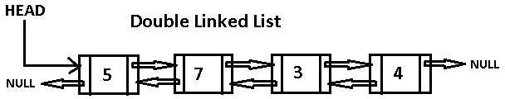
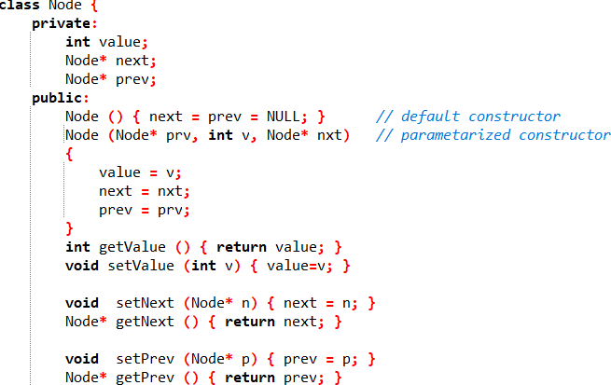
DLL Creation
Node Class

Slide 5
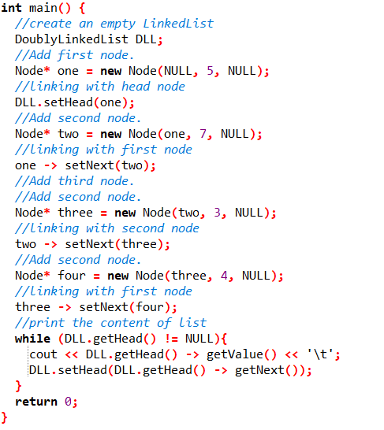
DLL Creation
Main Function

Slide 6
Doubly Linked List (DLL)
Linked list in which every node has a next pointer and a back pointer
Every node contains address of next node except last node
Every node contains address of previous node except the first node

Slide 7

DLL Creation (Better approach)
Tail
Add ‘tail’ pointer in your consideration in DLL class to control the interactions with the end of the DLL easily.

Slide 8
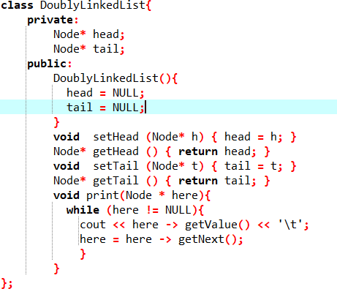
Traversing in DLL

Slide 9

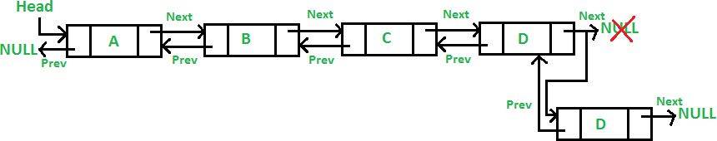
Insertion at the tail:
E

Slide 10
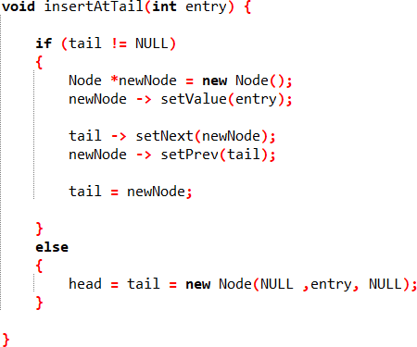
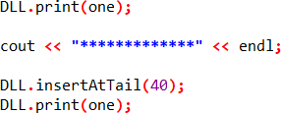

Insertion at the tail:
In DLL Class
In main function

Slide 11
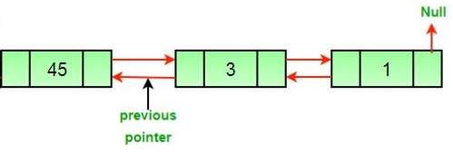
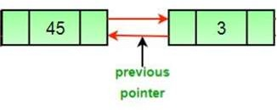
Deletion from the tail:
head
tail
head
tail
null

Slide 12
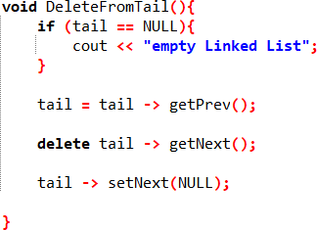
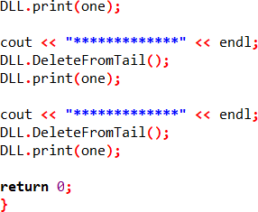

Deletion from the tail:
In main function
In DLL Class

Slide 13

circular singly linked list
A circular linked list is a linked list where all nodes are connected to form a circle.
Generally, the last node of the linked list has a NULL in the address field.
But a circular linked list has the address of the head node in the address field of the last node.
To implement a circular singly linked list, we take an external pointer ‘tail’ that points to the last node of the list. If we have a pointer last pointing to the last node, then tail-> next will point to the first node.
Tail

Slide 14
Why Circular Linked List?
To be able to insert and delete nodes at the front and at the end of the list without using a loop
For the insertion of a node at the end, the whole list has to be traversed.
If instead of the ’head’ pointer, we take a pointer to the last node ‘tail’, then there won’t be any need to traverse the whole list. So insertion at the beginning or at the end takes constant time, irrespective of the length of the list.

Slide 15
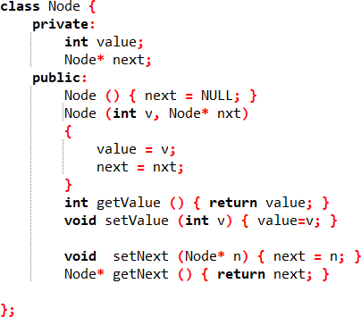
circular singly linked list implementation (Add to tail & print)
Node Class

Slide 16
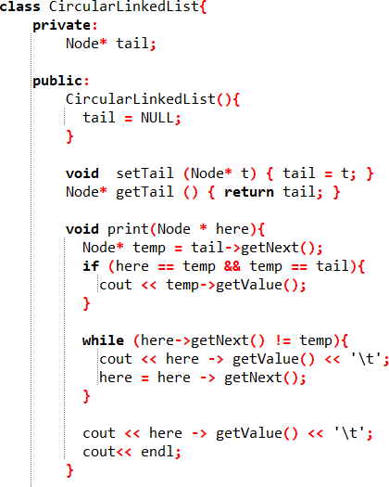
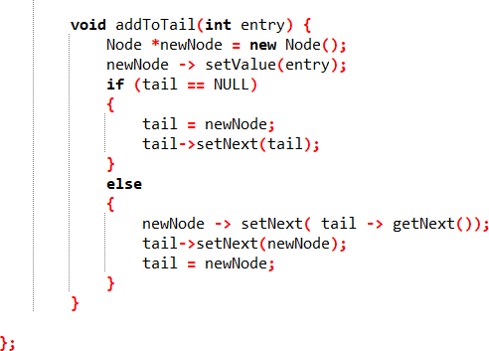
circular singly linked list implementation (Add to tail & print)
CLL Class

Slide 17
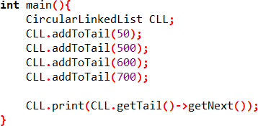

circular singly linked list implementation (Add to tail & print)
In main function

Slide 18



Task of Today
Implement the method to delete specific position from Doubly linked list given the position (int) as a parameter of the method.
You should start from the uploaded file on moodle “Lab4_task_beginning_for_students”
You must rename the file with format “yourID_yourName_lab4_task”
Function name “remove_at_position(int position)”
The method will return Boolean variable.
The method returns true if the value deleted.
The method returns false if the value doesn’t be deleted.
10
See the next slide to get required output

Slide 19
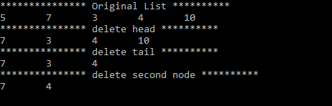
Task of Today
In main function you should follow below ordering in calling to try all cases of deleting that:
delete head “remove_at_position(1)”
delete tail “remove_at_position(4)”
delete second node “remove_at_position(2)”
delete out of range “remove_at_position(6)”
You should get the below output:

Slide 20
Thank you.

